Slide 1
Assignment
Week 5 – Salesforce Training & Project Progress
Date: Friday October 28, 2022
Student: Thanh Nguyen
GitHub: www.github.com/tvn9

Slide 2
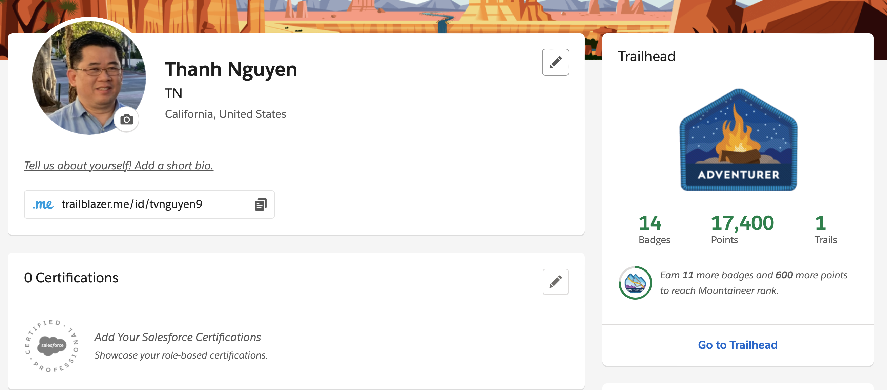
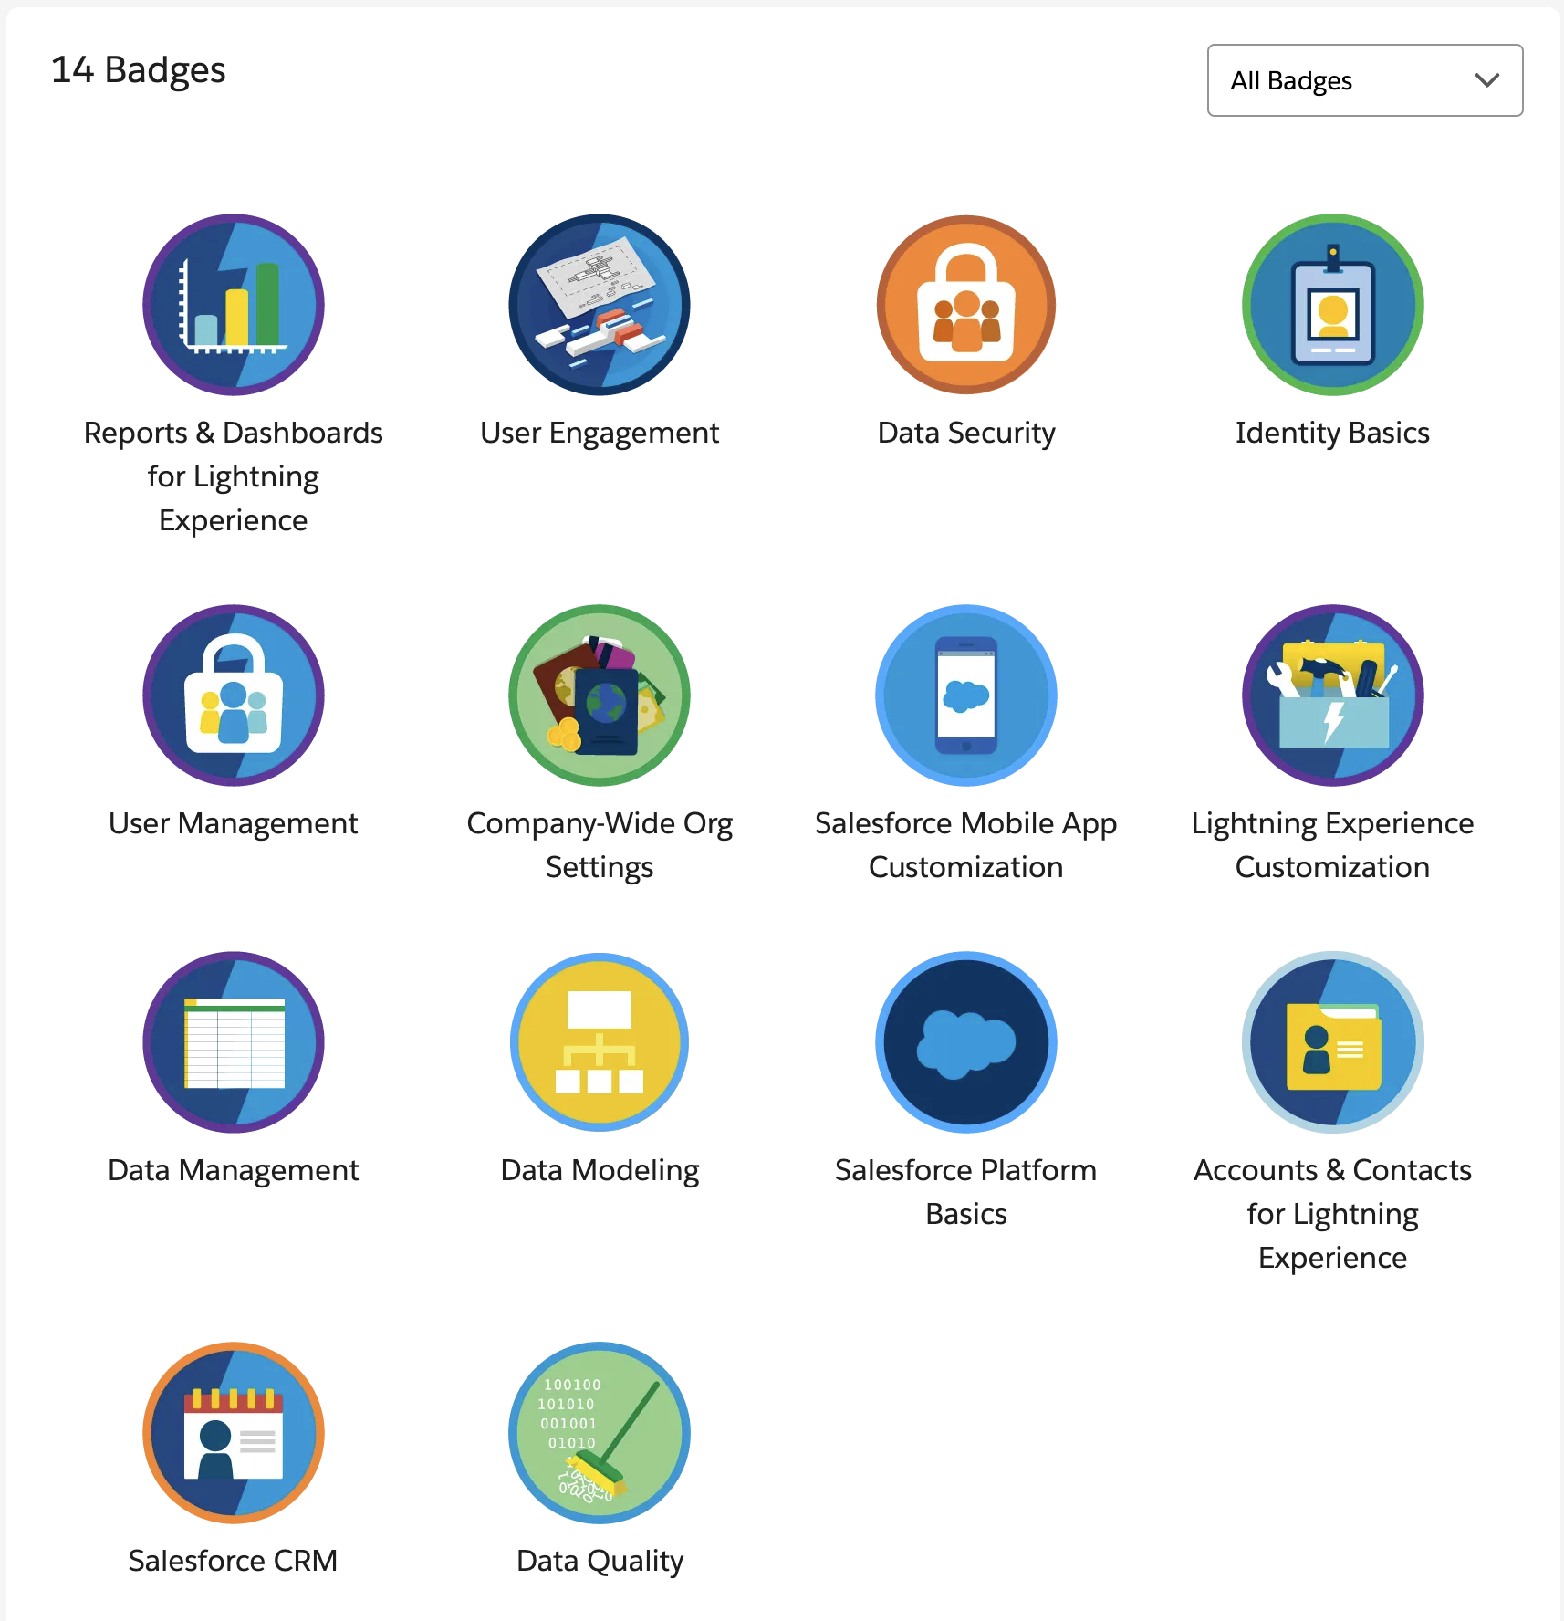
Trailhead Progress

Slide 3
Subject I have Learned
Flow
Apex
Practice SF Exam Questions/Answer

Slide 4
TNFS – IT Infrastructures Project
Project Name: TNFS - IT Infrastructures - Phase 1
The project goals is to:
Analyze the business story and define the core business functions and operations that are directly affecting the business daily activities (Executive Team, HR, Sales & Marketing, IT Engineer, Operation, Sourcing, Finance, Legal and Training,…)
Build the IT infrastructure systems that will enable the company to manage day-to-day business activities.
Notes:
Project name
Clear and concise goals

Slide 5
TN Food Services
Business Fundamental Story
TN Food Services company (TNFS) is a subscription base virtual kitchens with the best door-to-door food delivery services, TNFS’s customers can learn about the company’s products and services via its online store, customer could customize the meals choices and delivery schedule and create a subscription that meet their lifestyle or simply select from the smart list of predefined meal ideas and subscription options that meet most family and individual needs. The final step is to finish with a friction less check out process by submit the order, then wait for on time delivery service.
Some of the best values to our community are quality meals every day, no cooking time, no mess to clean up, and no waiting inline for a meal, just to name the obvious benefits.
Notes:
What is TN Food Services?
Subscription base business
Virtual kitchens
explain more about virtual kitchen if some one ask question
Door to door delivery services
Customer – learn more – products –services – on the website
On the website - select subscriptions – meet lifestyle
Or custom build a subscription
Final step – submit order – wait on time delivery services
Benefit – no cook time, no mess, no clean up, no waiting inline, and no clean up after meal

Slide 6
The Stakeholders & Benefits
With the rapid change in the economic world, public policies, human health, work environment, and lifestyle, the food services industries have been reshaping again in order to bring the best benefits to our communities around the country
The elderly members of every community needed help with every meal
The busy frontline workers - doctors, nurses, and other emergency services
The busy single parent needs the quality meal for their students everyday
The work from home workforce of every occupations
Food delivery companies, and Food suppliers, local farmers
Tech engineers (Salesforce plays the core role in shorten time-to-market for many small to major enterprise businesses)
Notes:
Rapid change in the economic world – public policies – human health – work environment – lifestyles – Reshape the food services industry
Whom benefit – elderly members – frontline worker – single parent – work from home
Salesforce play a key roll in the business management infrastructure
Analyze business and stakeholders – understand hour customer interact with the business…

Slide 7
TNFS – Website Requirements
Website (storefront)
Modern Frontend Website
Intuitive Navigation Menu System
Single Sitewide Search Box
Product Presentation Sections
Subscription Management Page (Account, Login required)
Customer Account Management Page (Account required)
Return/Refund Management Page (Account required)
Customer Support Page
Standard Site’s Legal Requirement Sections (Footer Area, Links)

Slide 8
TNFS – HR Requirements
HR Management Functions
Employee Contact Management
Payroll Management
Corporate Structure Management
Office Resource Management
Hiring / Firing

Slide 9
TNFS – Sales & Marketing Requirements
Sales Activities
Tracking online orders
Taking phone orders
Manage payments
Manage cancellation and refund
Perform corporate level sales and contracts
Managing leads / opportunities
Marketing Activities
Manage digital marketing campaigns
Manage local marketing activities
Track all marketing performance

Slide 10
TNFS – Operation Requirements
Operation department daily management tasks:
Every aspect of making daily meals for delivery
Food design activities
Food Inventory
Delivery services operation
Kitchen facilities, equipment and staffs
FDA Compliant and inspections

Slide 11
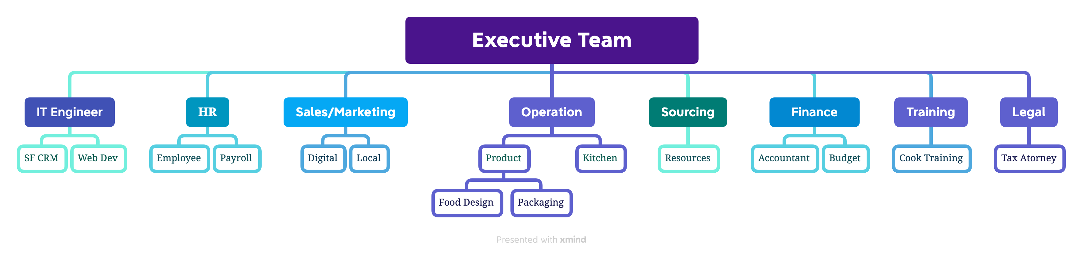
TNFS Company Structure

Slide 12
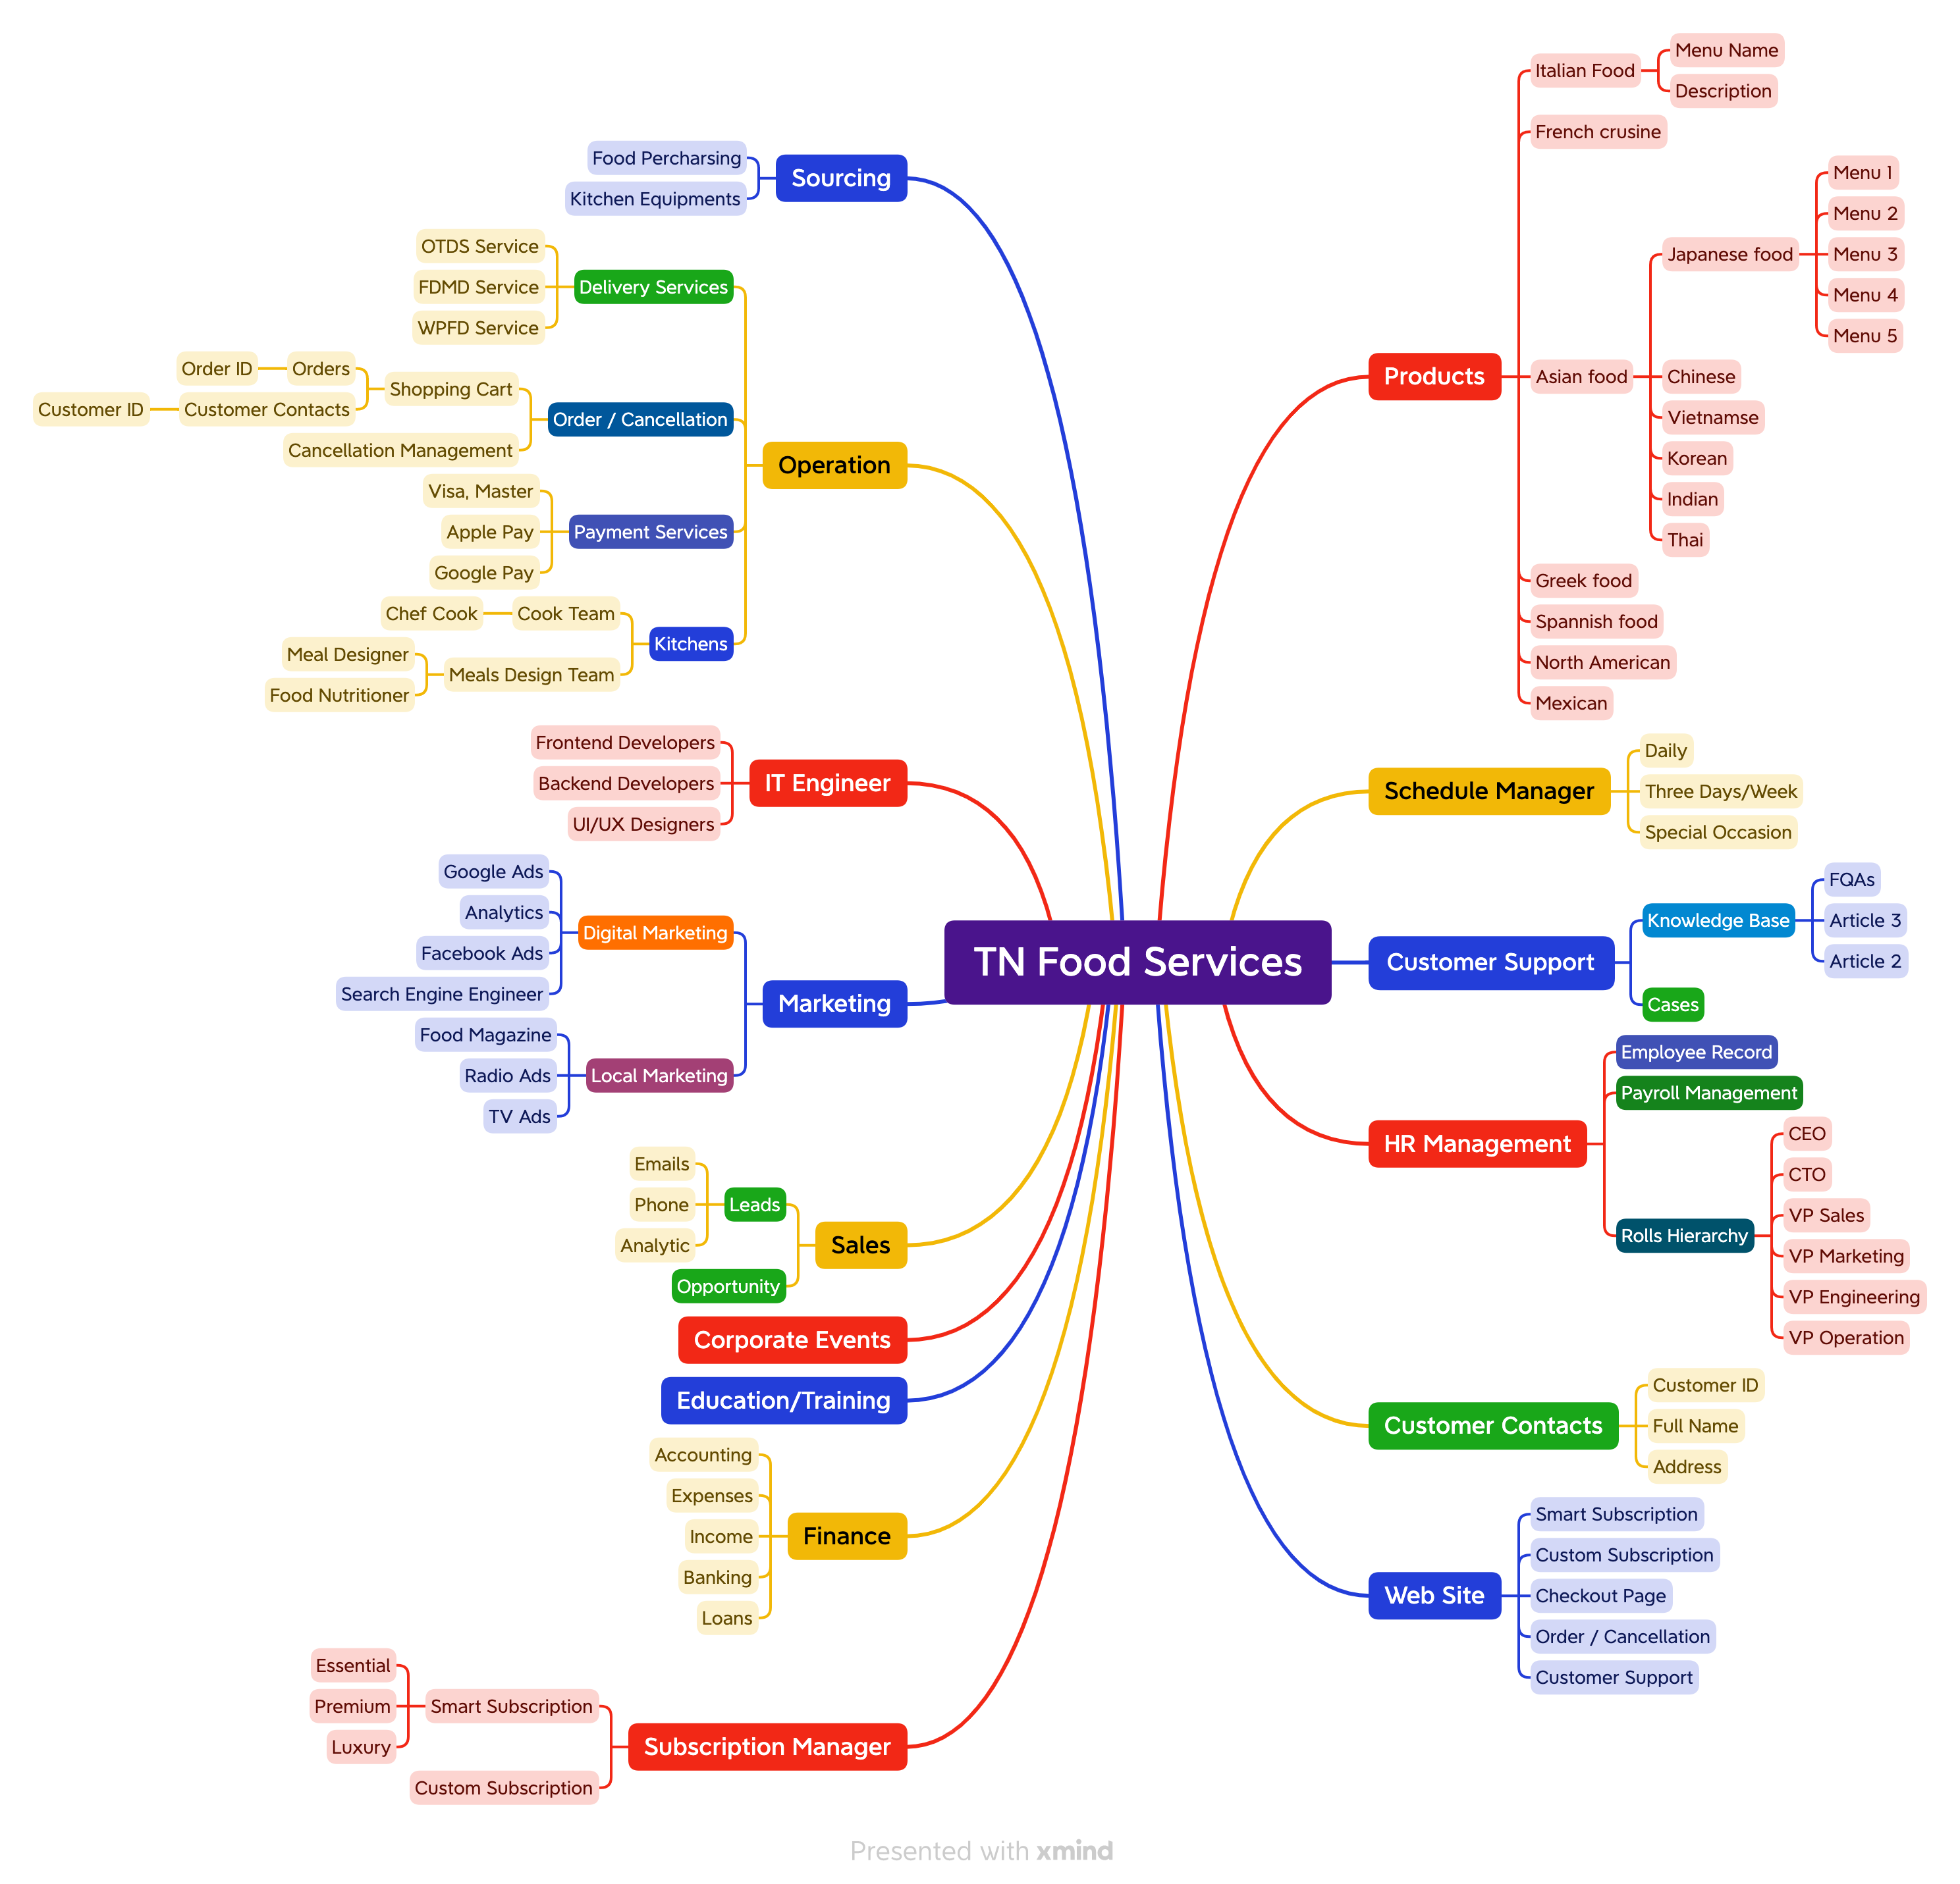
Mind Map Chart – In-progress

Slide 13
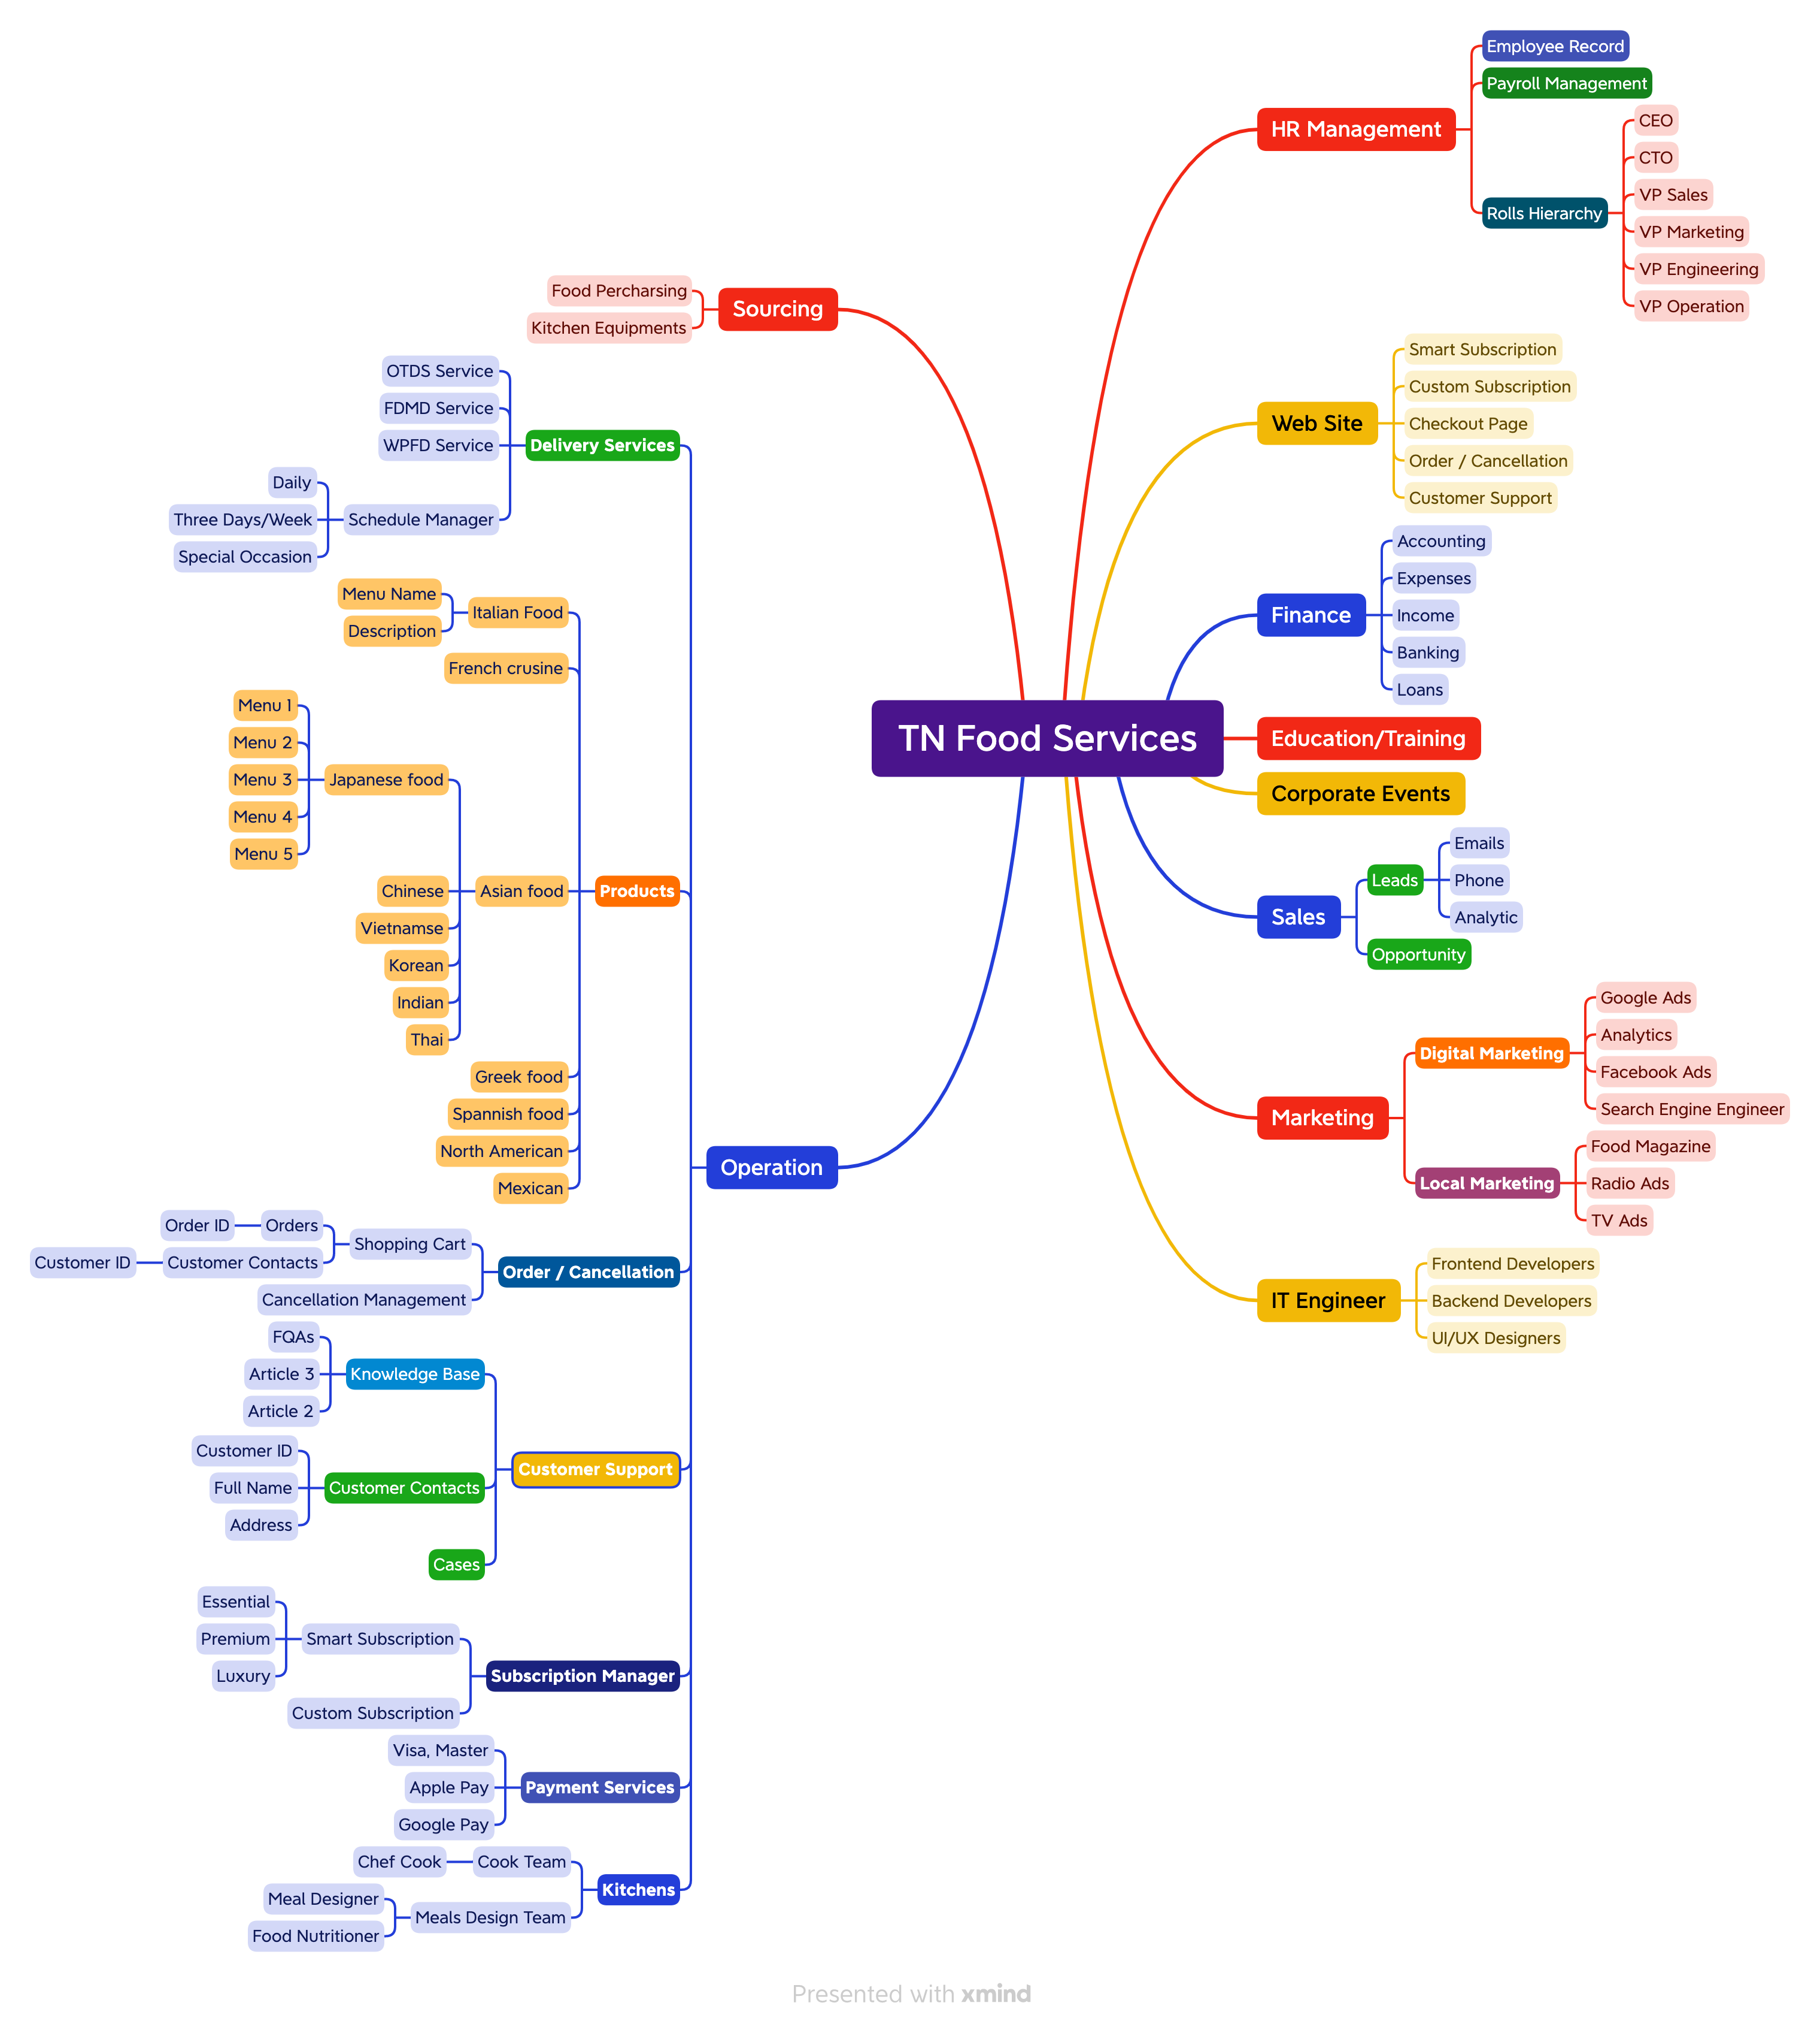
Mind Map Chart – In-progress

Slide 14
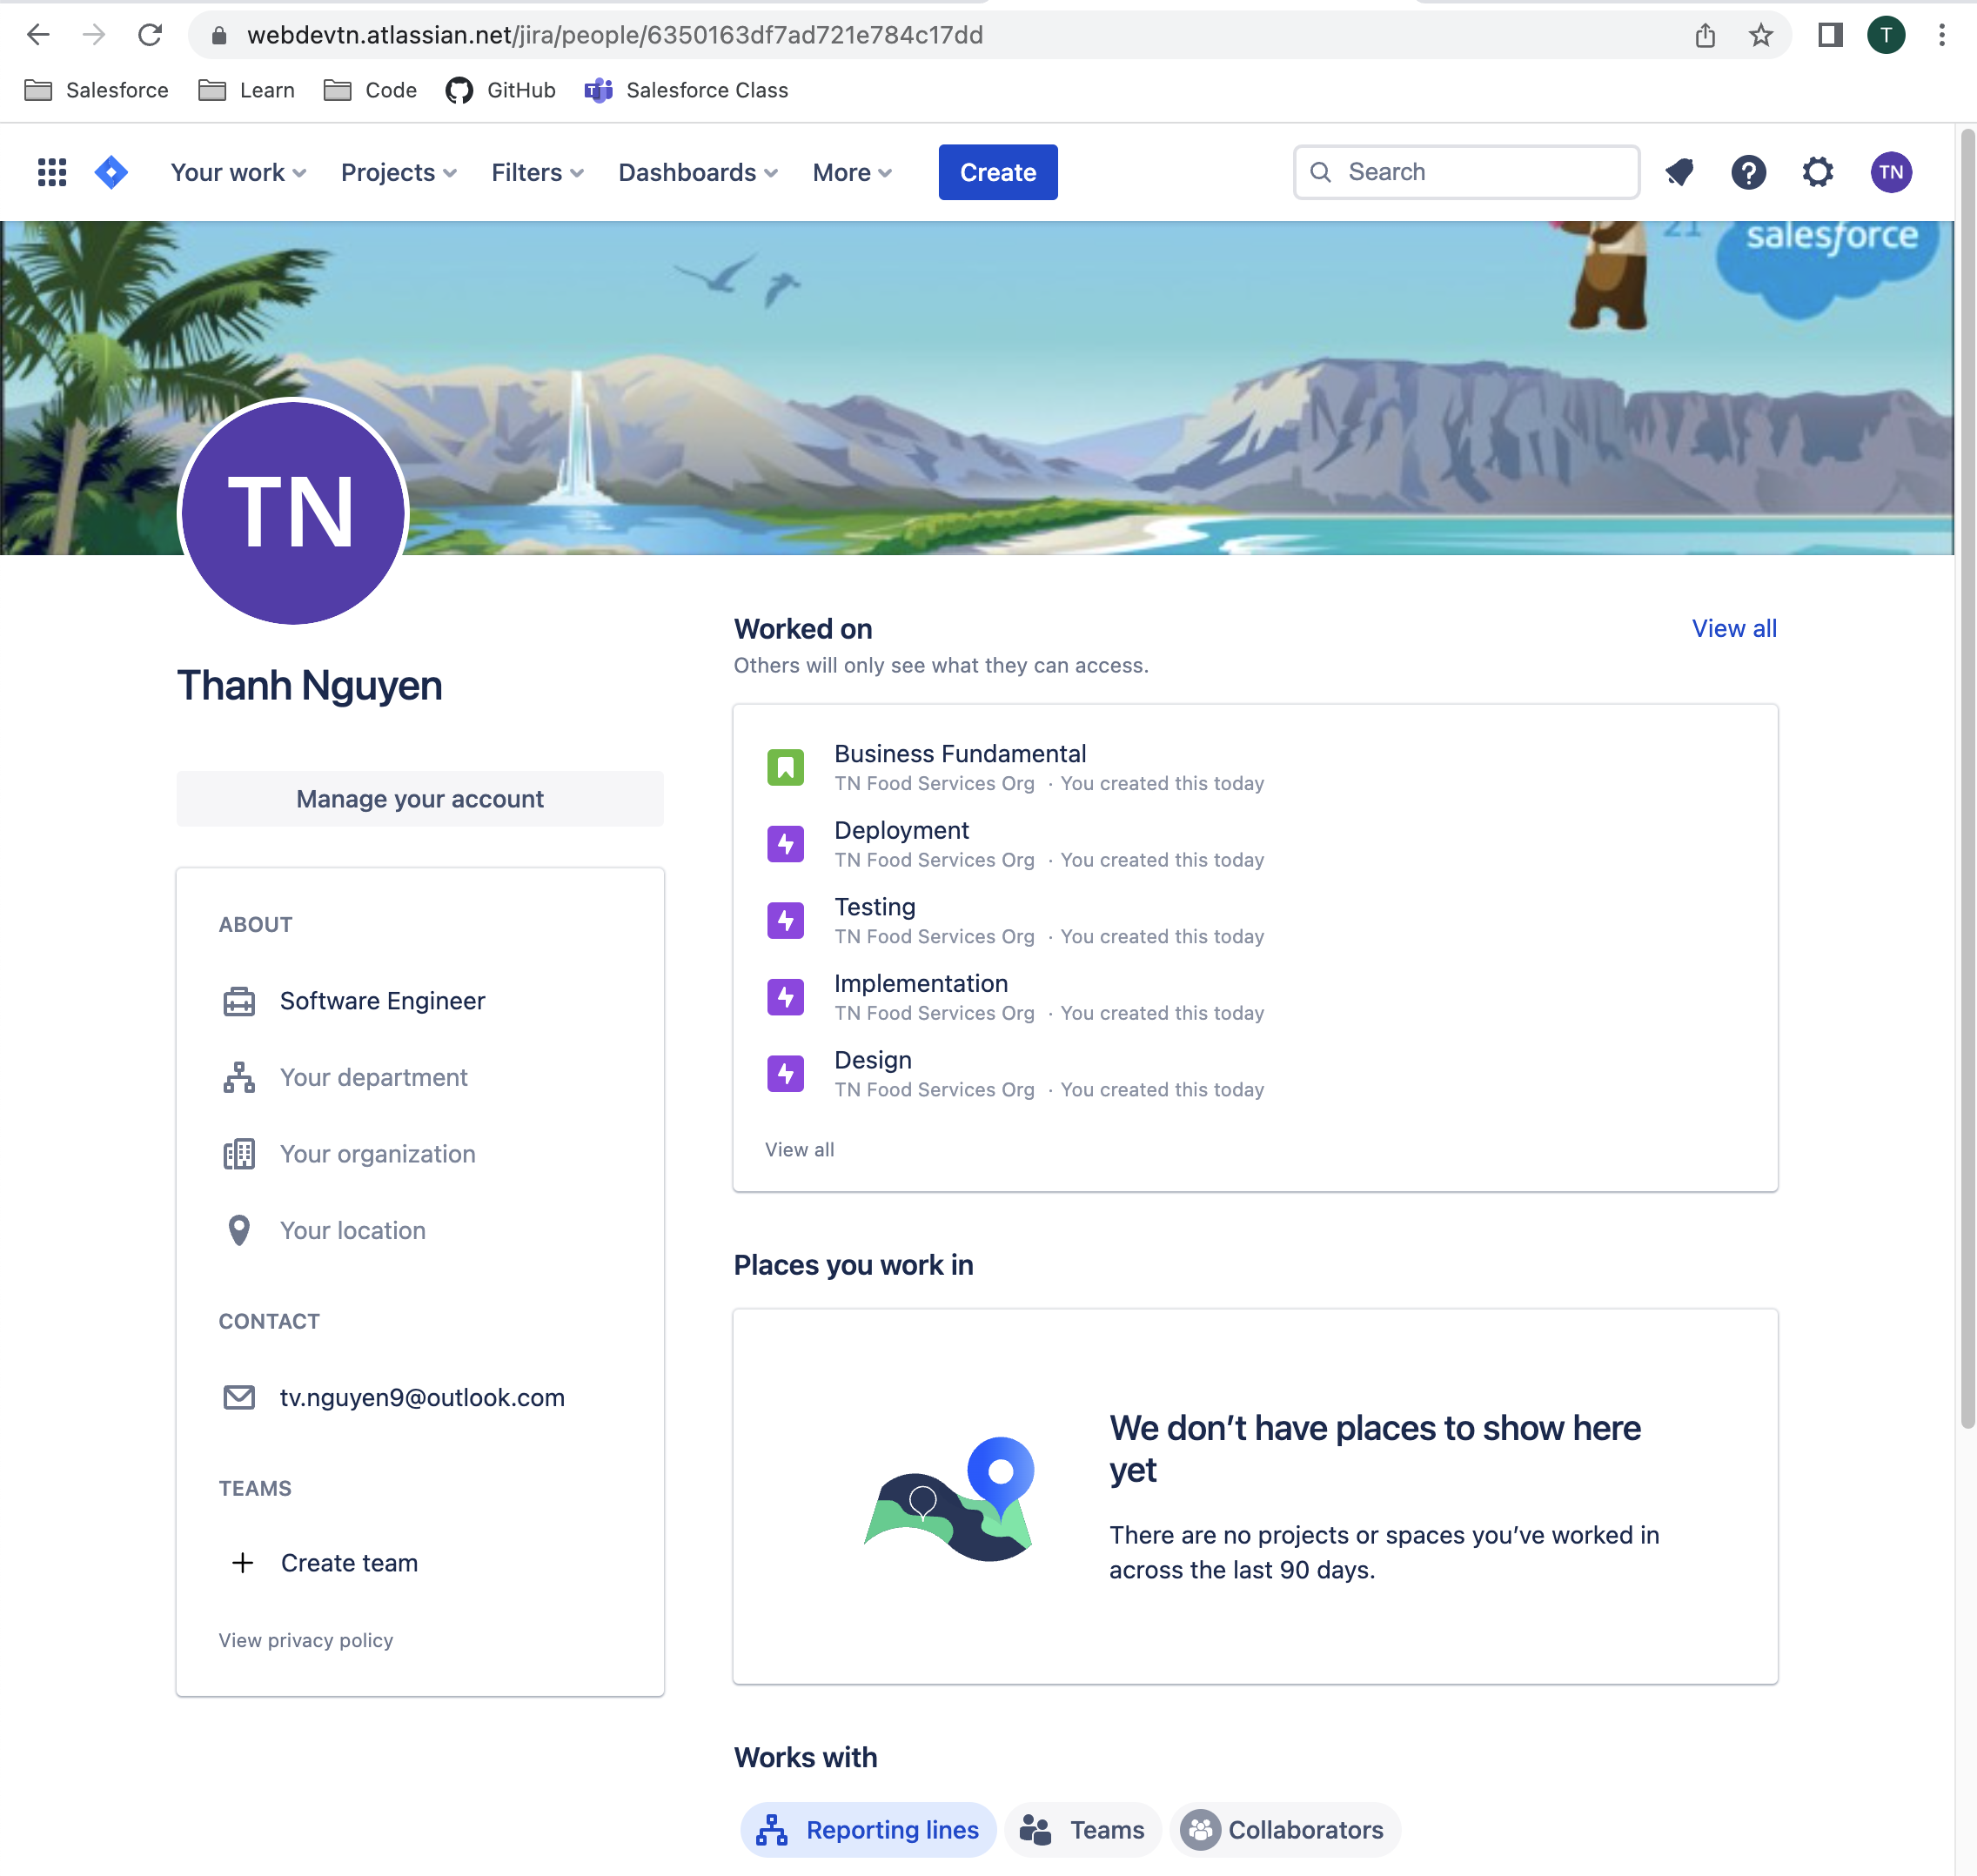
Project Management (Jira) – In-progress
Tasks:
Setup Jira Account - Done
Create Project Requirement – In progress
Design Specification – In progress
Implementation Plan
Development
Testing
Deployment

Slide 15

Concept Website

Slide 16
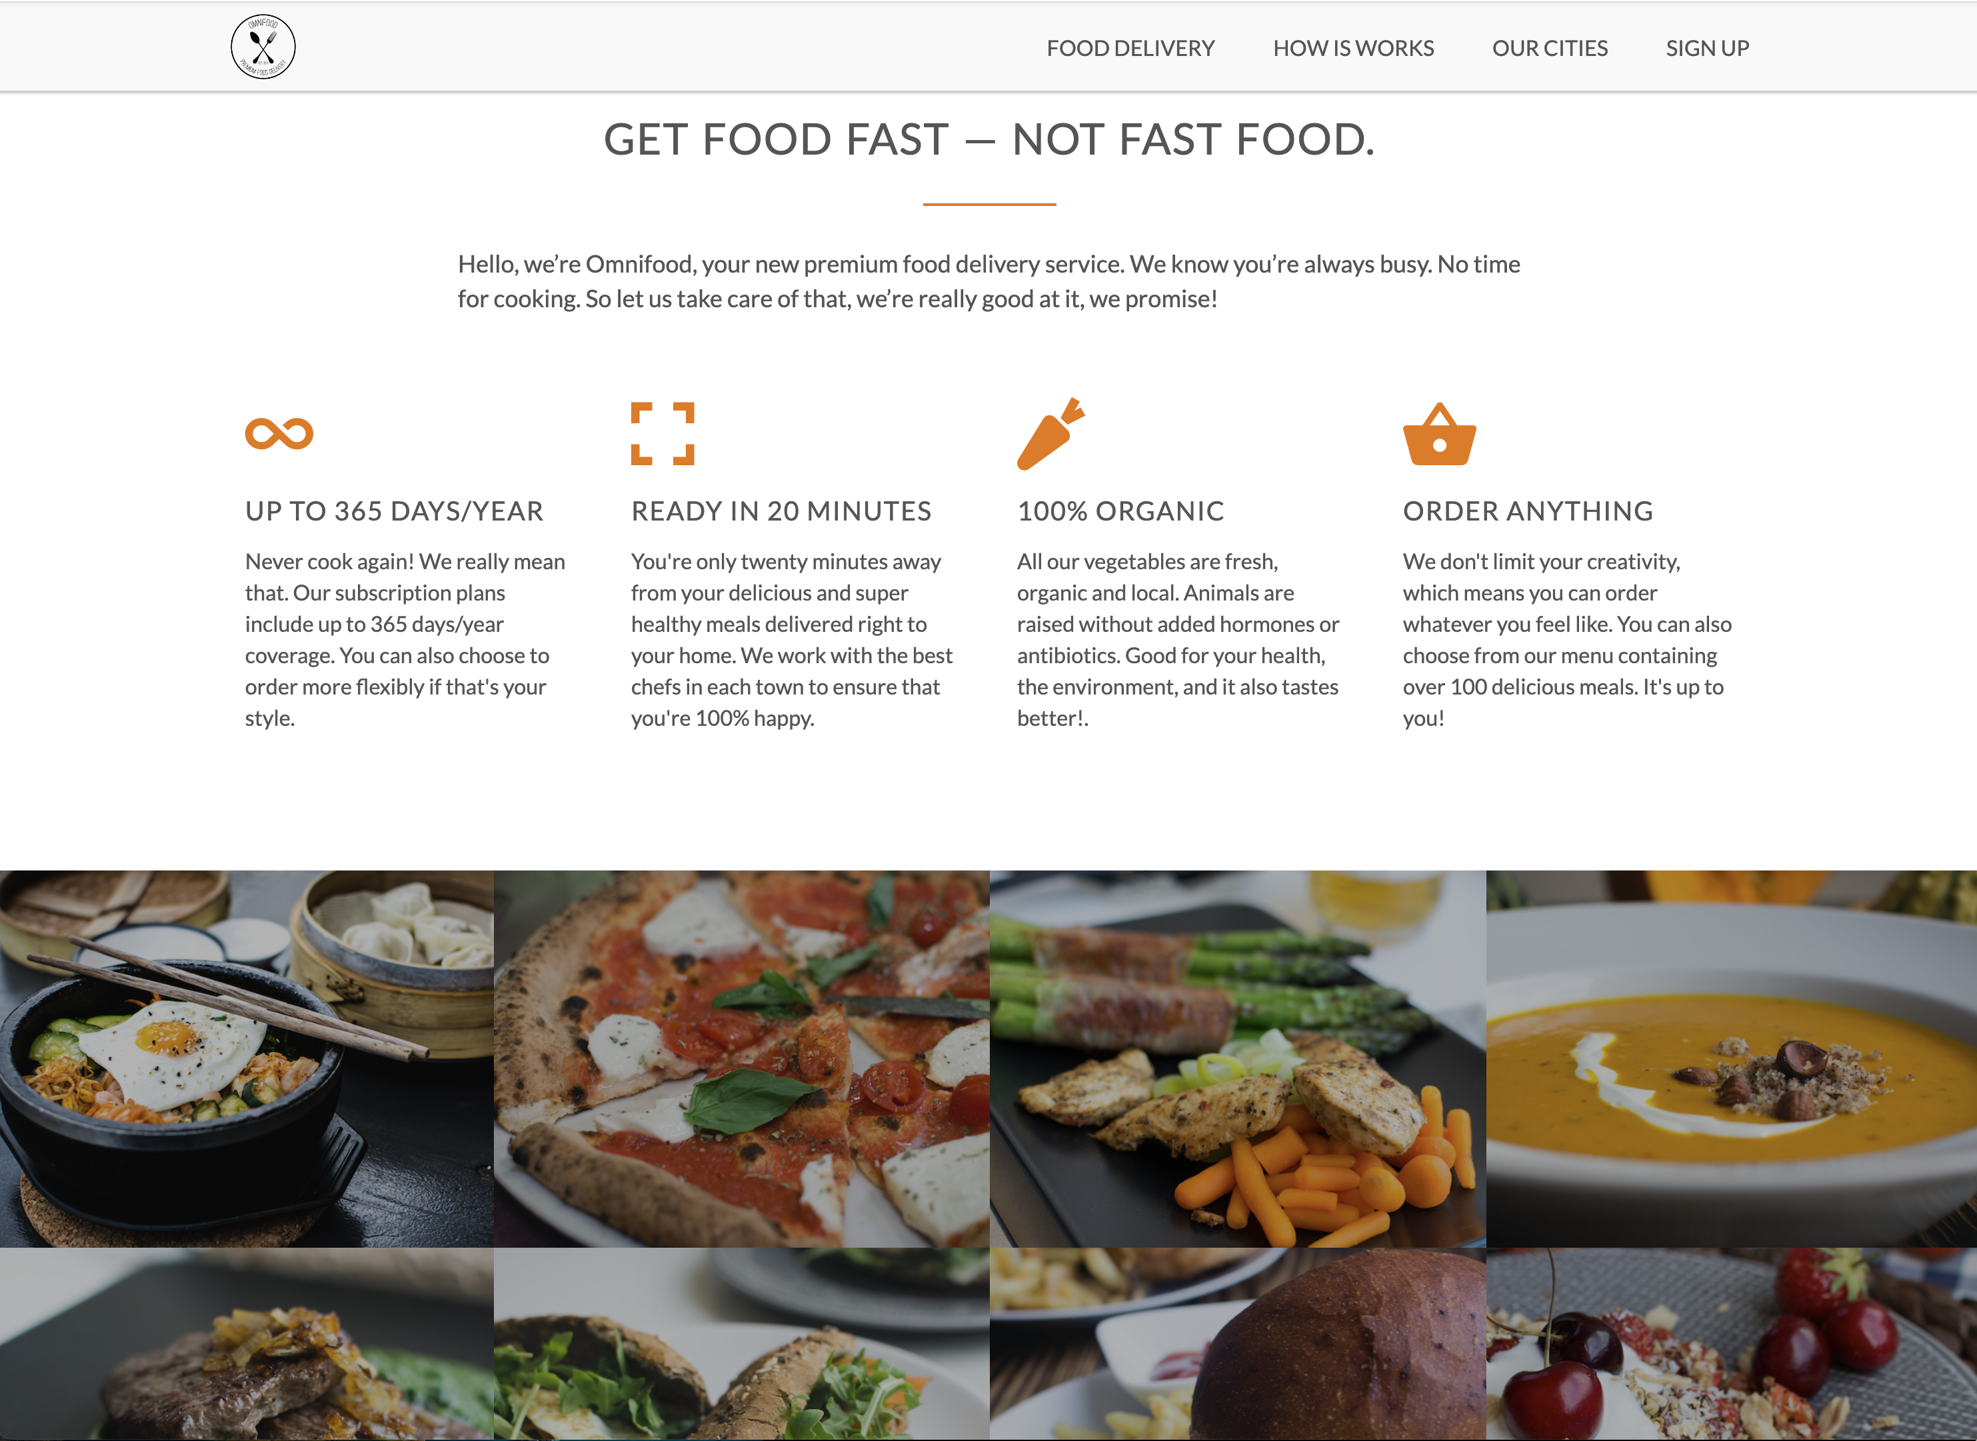

Slide 17
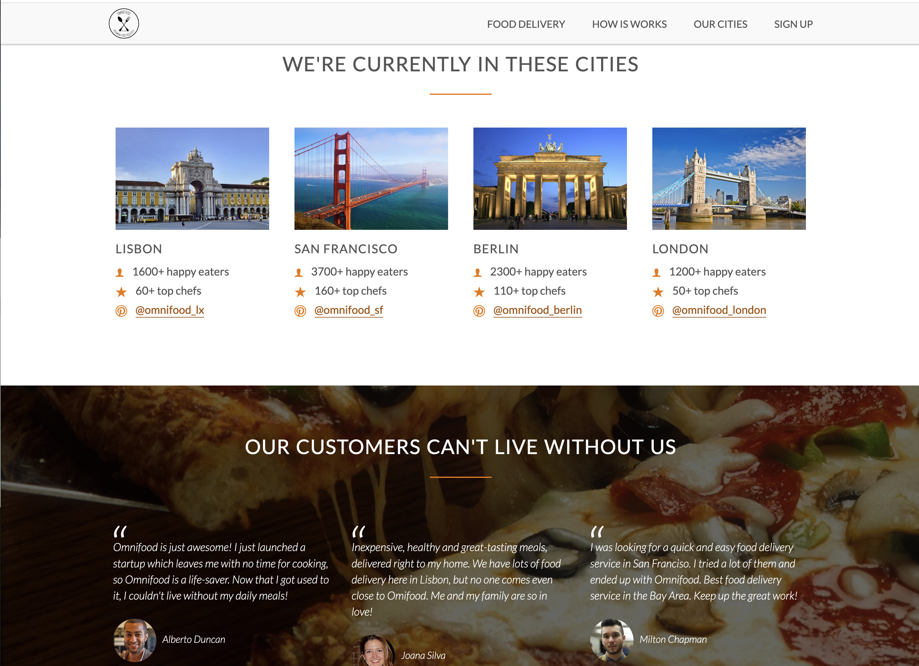

Slide 18
